Slide 1
LIFE EXPECTANCY
DATA ANALYSIS
Gelila Yimtatu

Slide 2
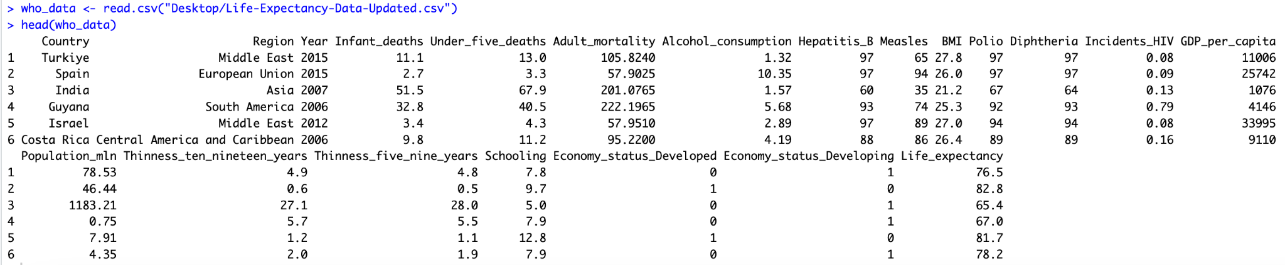
Introduction and Our Dataset
Unit of Analysis: 179 countries from 2000-2015, (2,864 rows)
21 Variables on: life expectancy, health, immunization, and economic and demographic information
Primary question: What are the most decisive predictive factors influencing global life expectancy?
Notes:
All of us?
Life expectancy, the average amount of years a person is expected to live, is crucial to assessing population health. A measure of who we are, how we live, and what shapes a healthy life. In our global health class, we learn about life beyond just being a health metric, as it ties to policy-making, healthcare investment, community/schooling environments, and resource allocation. With this in mind, we wanted to look at all these factors and conduct a statistical analysis on its many factors.
Most studies undertaken in the past on factors affecting life expectancy considers primarily demographic variables, income composition and mortality rates. This Life Expectancy dataset we have found from WHO (World Health Organization) goes beyond.
It takes into account factors like the HDI, which is a holistic measure assessing country development (using not only economic growth but also average annual income, education and more).
Also this dataset includes immunization factors like Polio and Hepatitis B, which is important because
Plus, most of these studies relied on single-year global data. This dataset spans from 2000 to 2015.
Our data consists of about 179 countries from (as mentioned from) the years 2000-2015. There are originally 21 variables and 2,864 rows to start with.
Our primary question was: What are the most decisive predictive factors influencing global life expectancy?

Slide 3
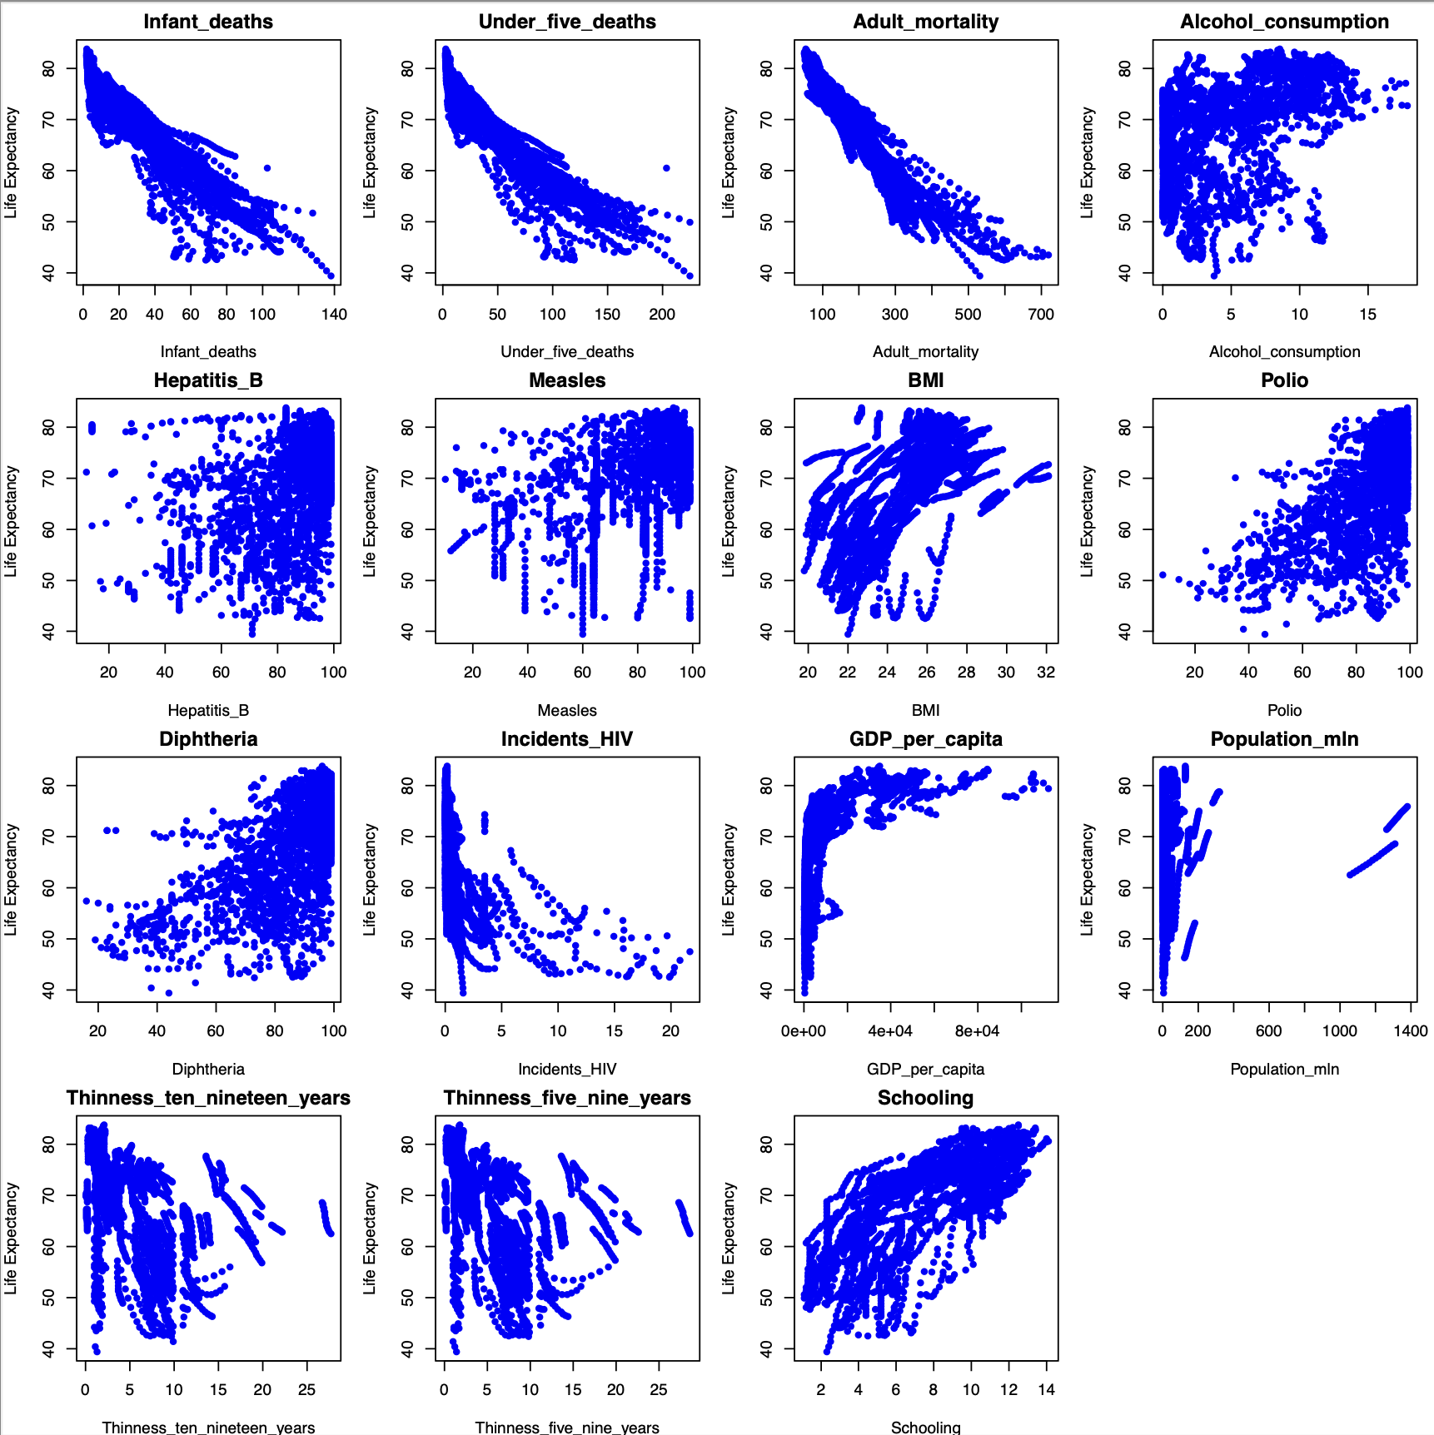
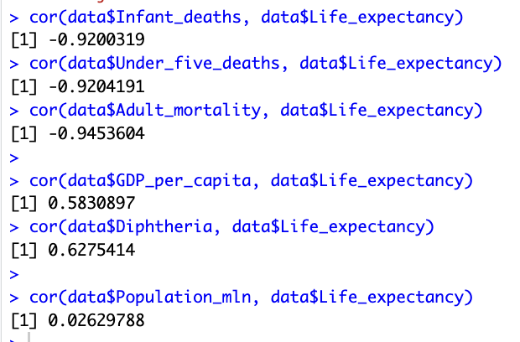
Preliminary Data Exploration
Removing Unnecessary Variables
  Country, Region, Year,
  Economy_status_Developing/Economy_status_Developed
Notes:
Gelila
We removed four variables: Country, Region, Year, and Economy_status_Developing/Economy_status_Developed.
While the country or region associated with each data row could be valuable for geographical analysis, these variables do not directly contribute our research question! We want to understand the statistical relationships between key health and socioeconomic factors affecting life expectancy. Categorical variables like this don’t directly influence it.
Logically, adult_mortality was removed as well
To start we began with preliminary data exploration. From plotting one can see that:
Schooling, GDP_per_capita, and Diphtheria-> a positive (ish) correlation with life expectancy, suggesting that higher levels of these factors contribute to longer lives
Some variables, like Population_mln, show weak or inconsistent relationships, indicating they may have limited direct influence on life expectancy.
Then we looked at the correlation of this to double check. Testing the correlation between a few of the variables and Life Expectancy have shown that this dataset will be useful to test the influence of predictive factors on Life Expectancy.

Slide 4
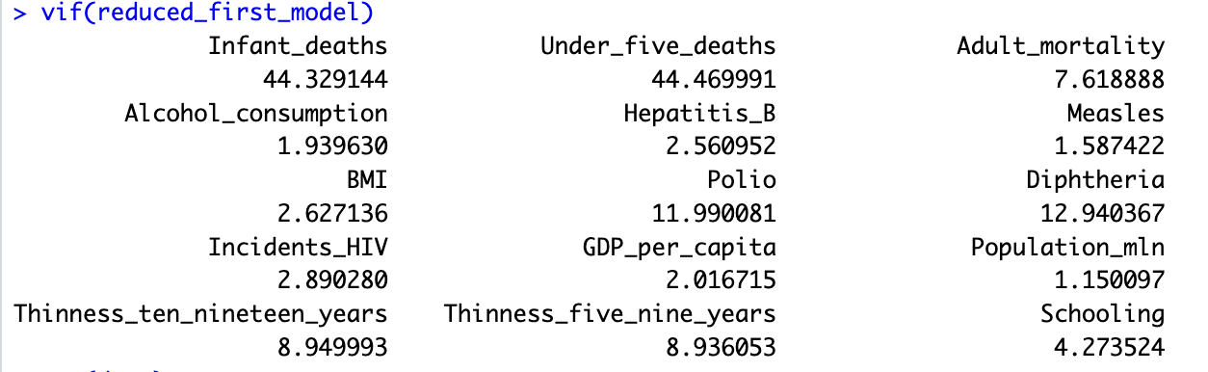
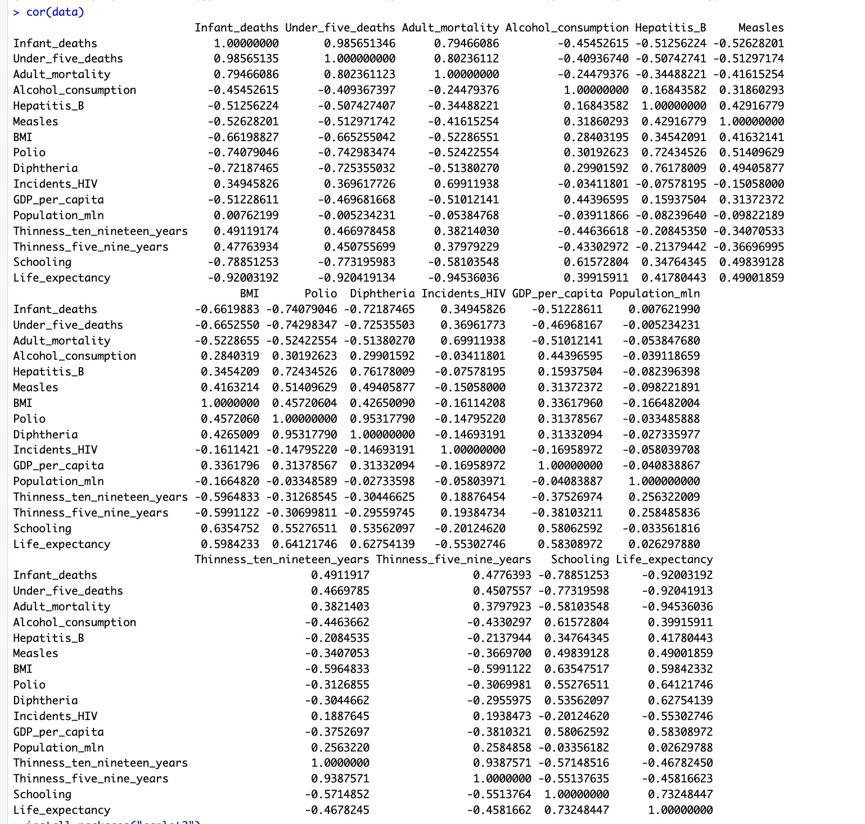
VIF
Cross check with Correlation matrix
The VIF test suggests there is multicollinearity with infant deaths, under 5 deaths, diphtheria, and polio (>10), and after cross-checking with our correlation matrix we removed these variables.
Much better (VIF<10)!
Notes:
Variation Inflation Factor

Slide 5
Variables after VIF
Dependent variable: Life_expectancy
Independent variables (10): Alcohol_consumption, Hepatitis_B, Measles, BMI, Incidents_HIV, GDP_per_capita, Population_mln, Thinness_ten_nineteen_years, Thinness_five_nine_years, Schooling

Slide 6
01
First Order Model

Slide 7
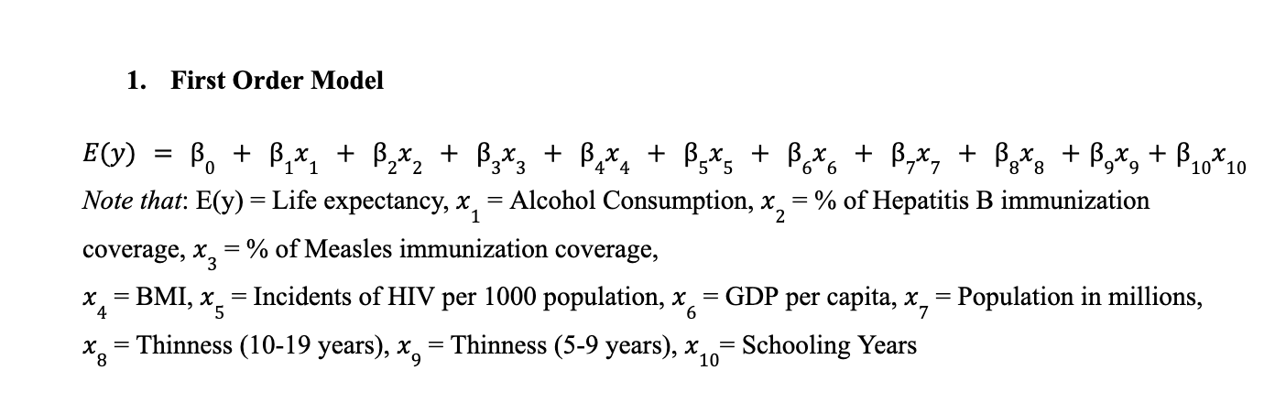
Notes:
To begin our analysis, we started with creating a first order model. This model depicts the relationship between life expectancy as a function of our independent variables. The equation for our first order model is as follows.

Slide 8
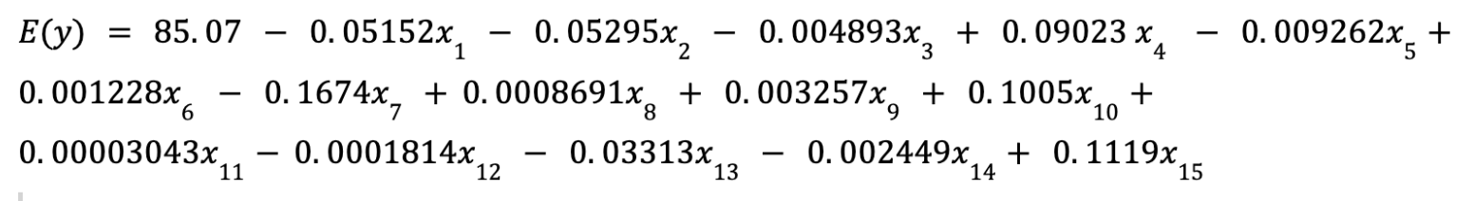
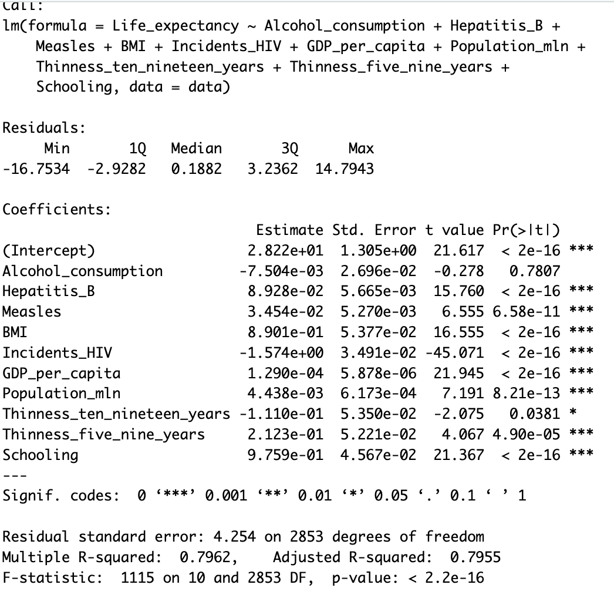
α = 0.05
P = 2.2e-16 < 0.05
Reject H0, can conclude the model is useful and proceed!

Slide 9
02
Stepwise Regression

Slide 10
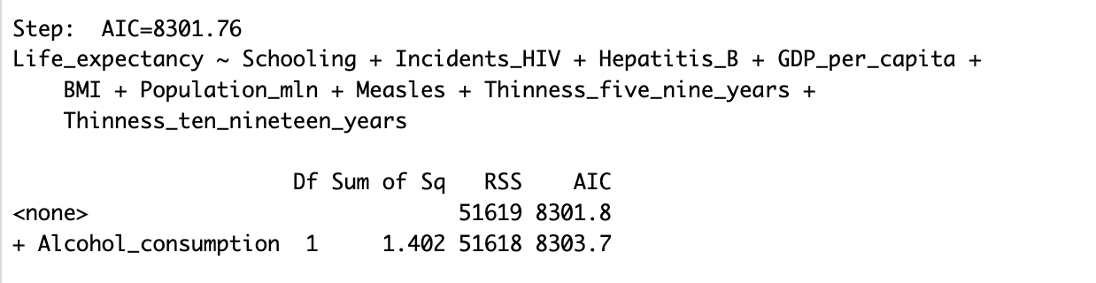
Forward Stepwise Regression
Variable that was removed:
Alcohol consumption
Notes:
The variables that were removed were Polio, Measles, Diptheria, Population in millions, and Thinness five-nine years

Slide 11
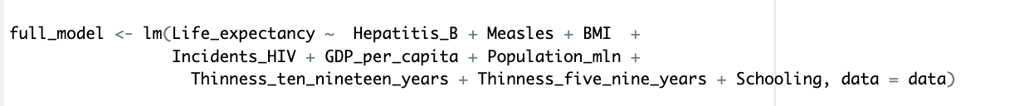
Stepwise Conclusion
Our stepwise forward shows 9/10 of our starting variables to be statistically significant:
  Both stepwise regressions removed alcohol consumption as a variable
  After checking the p-value (0.7807) from our model summary, we decided not to include it in our parsimonious model
Our new first order model:

Slide 12
Final Variables
Dependent variable: Life_expectancy
Independent variables (9):
Hepatitis_B, Measles, BMI, Incidents_HIV, GDP_per_capita, Population_mln, Thinness_ten_nineteen_years, Thinness_five_nine_years, Schooling

Slide 13
03
Comparing Models
(Four in total)

Slide 14
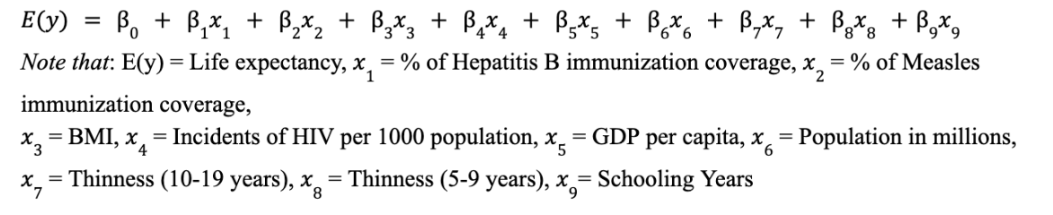
Model 1: First order complete
Notes:
We then ran backwards stepwise regression. Same output.

Slide 15
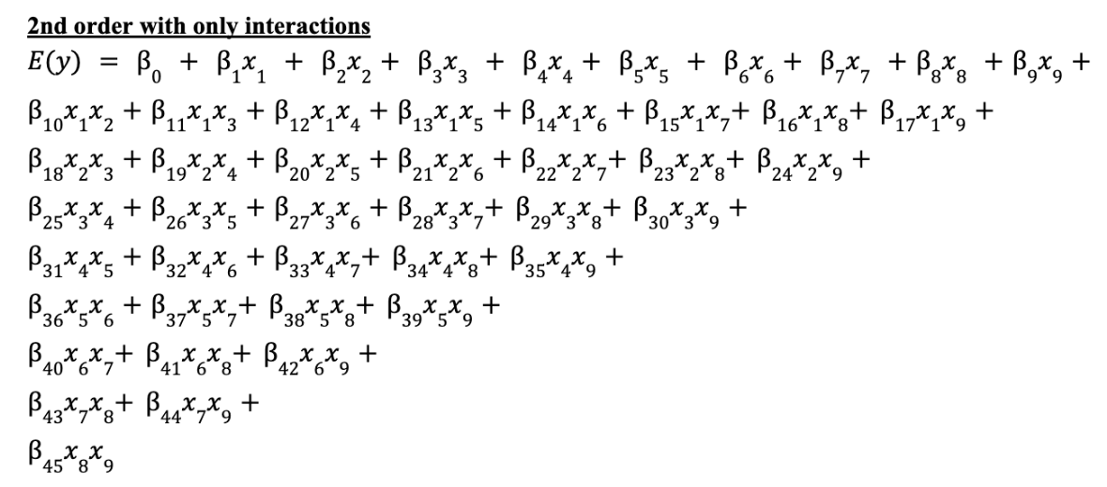
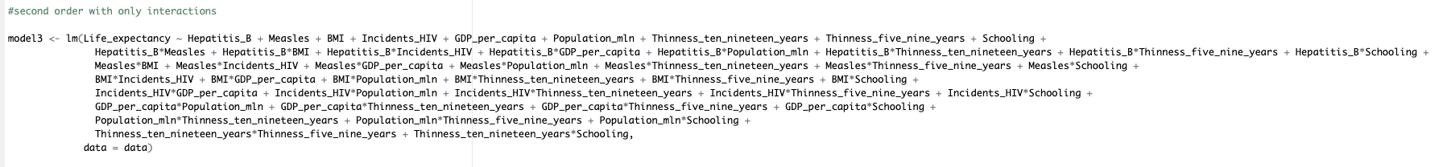
Model 2: Second Order with Only Interaction Terms
Notes:
We then ran backwards stepwise regression. Same output.

Slide 16
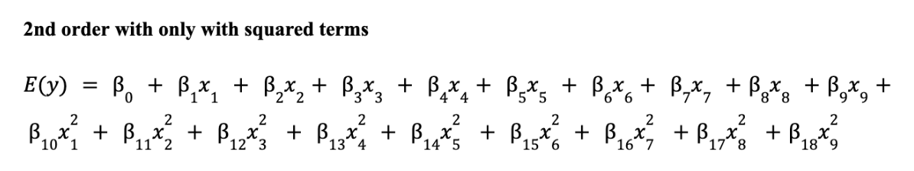
Model3: Second Order with Squared Terms
Notes:
We then ran backwards stepwise regression. Same output.

Slide 17
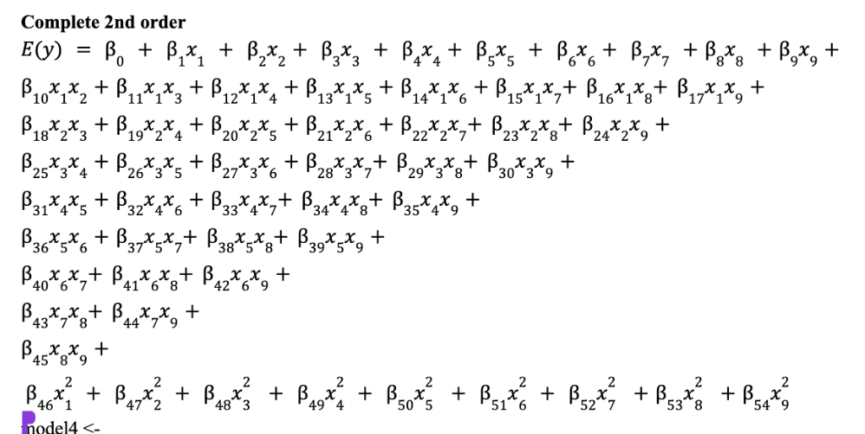
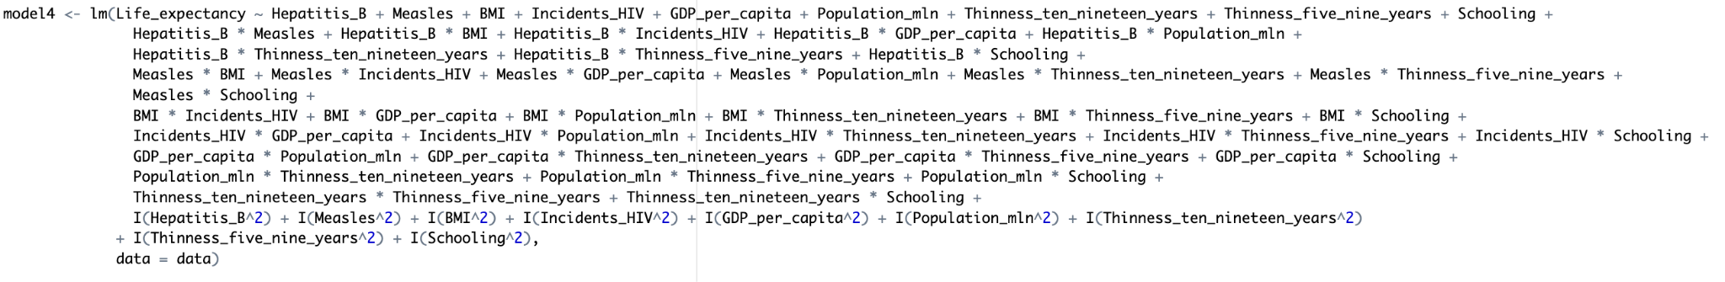
Model4: complete second order
Notes:
Hypothesized a complete 2nd order model

Slide 18
ANOVA - Nested F Test
Anova Test | Hypothesis | Result
Complete 2nd Vs. 2nd order Squared only Anova(model4, model2) | H0: B10=…B44=B45=0 H1: at least one of the interaction term’s B’s is nonzero | P value = 2.2e-16 *** < alpha = 0.05 Reject H0, at least one of the interaction terms Betas is nonzero
Complete 2nd Vs. 2nd order interaction only Anova(model4, model3) | H0: B46=…B53=B54=0 H1: at least one of the squared terms B’s is Nonzero | P value = 2.2e-16 *** < alpha = 0.05 Reject H0, at least one of the squared terms is nonzero
Complete 2nd Vs. Complete First Anova(model4, model1) | H0: B10=…B53=B54=0 H1: at least one of the second order terms is Nonzero | P value = 2.2e-16 *** < alpha = 0.05 Reject H0, at least one of the second order terms is nonzero
Notes:
Elijah

Slide 19
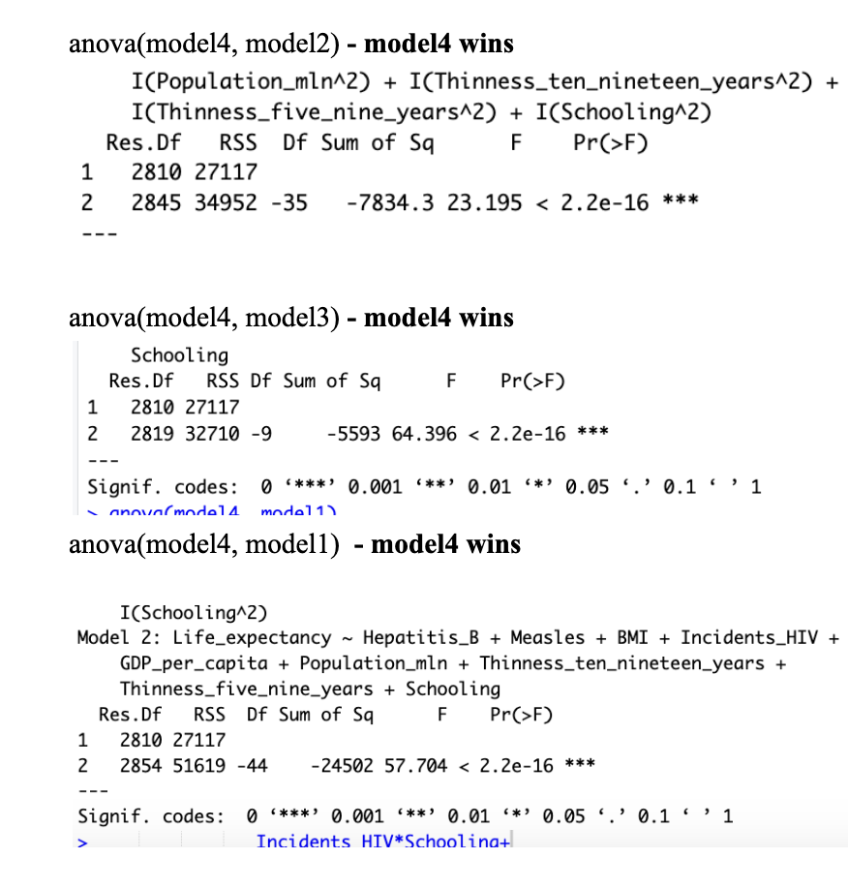
Model 4 wins!
Notes:
We then ran backwards stepwise regression. Same output.

Slide 20
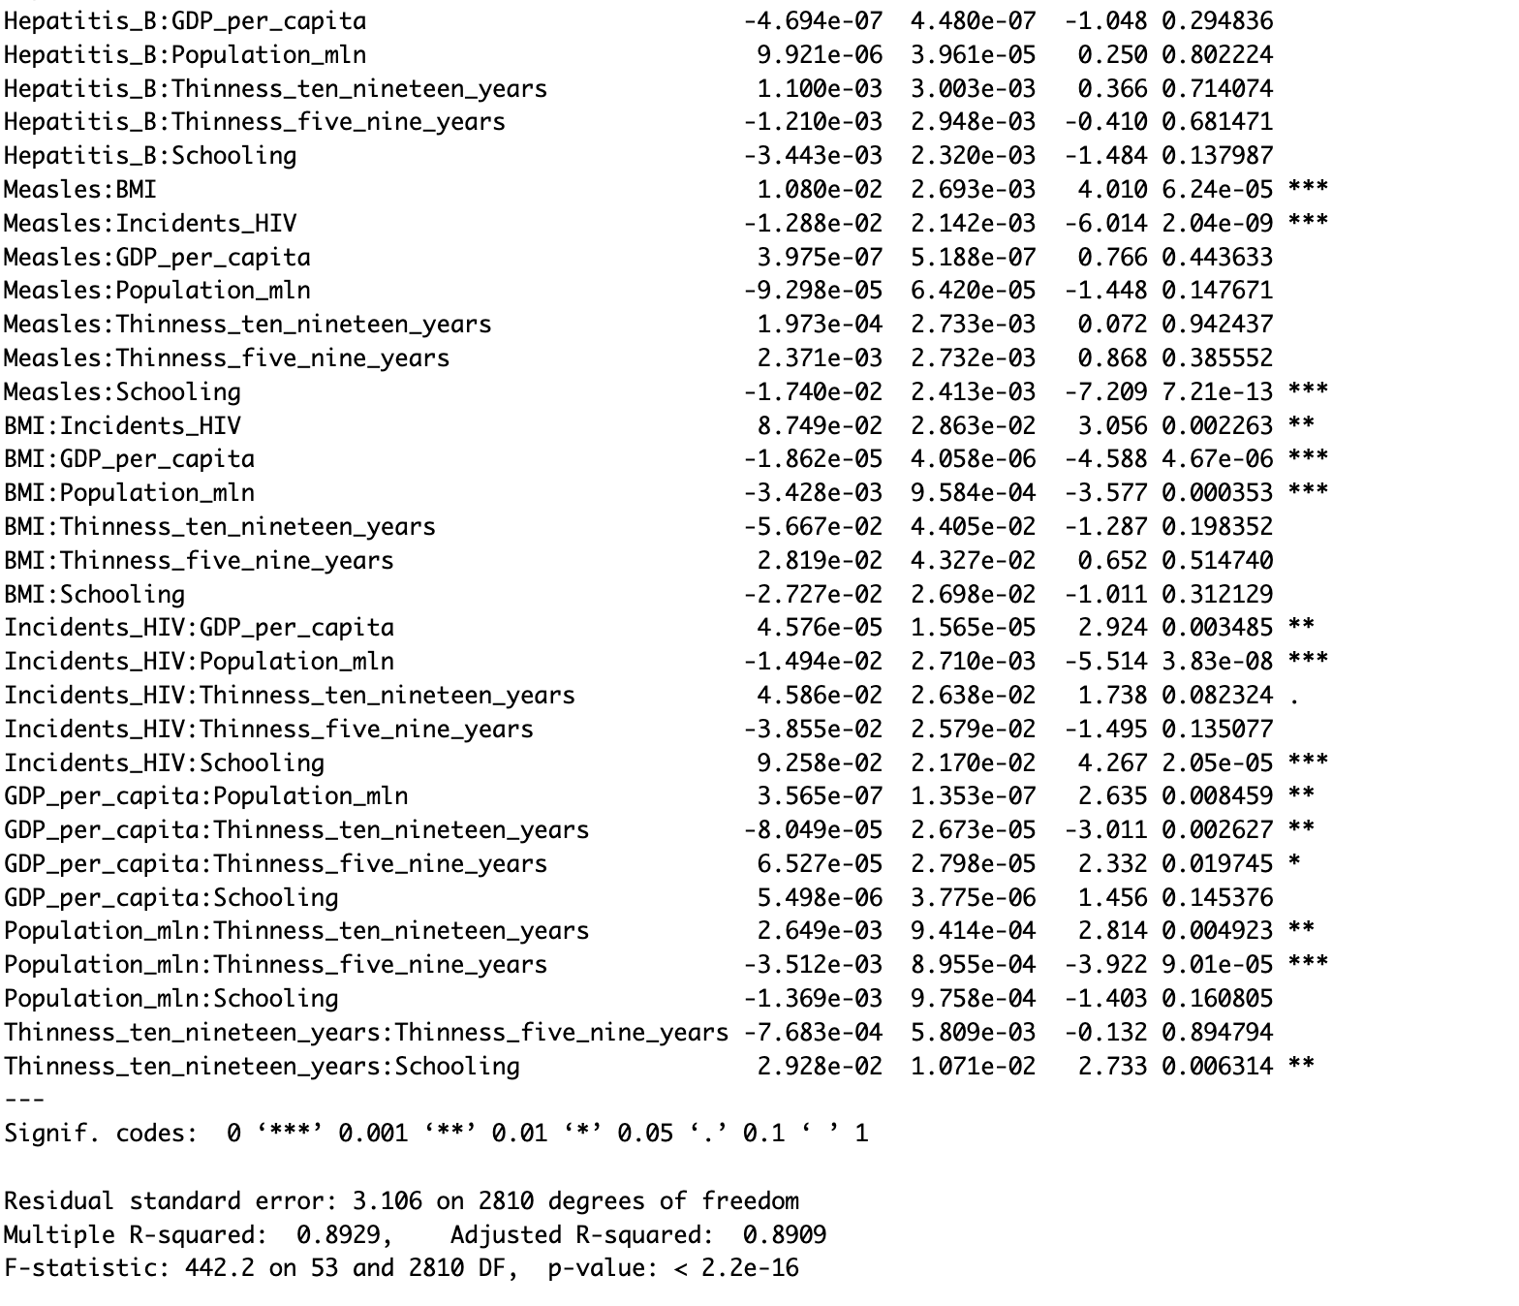
Statistically evaluating model utility - Global F test:
H0 : B1 = B2….= B53 = B54 = 0
Ha : at least one Bi /= 0
Reject H0
The extremely small p value indicates that the model is statistically adequate (<0.05). The additional predictors significantly improve the fit.
Notes:
We then ran backwards stepwise regression. Same output.

Slide 21

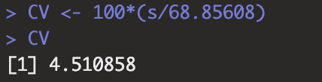
Statistically evaluating model utility - Global F test:
Residual Standard Error:
The complete second order model can predict life expectancy within 2s = 6.216 years of its true value.
Coefficient of Variation:
CV = 4.51
Relatively low, less than 10%
Adjusted R^2:
89.09% of the variance of life expectancy data is explained by the complete 2nd order model.
Notes:
Coefficient of variation the ratio of the estimated standard deviation of Epsilon to the sample mean of the dependent variable y bar. Measured as a percentage.

Slide 22
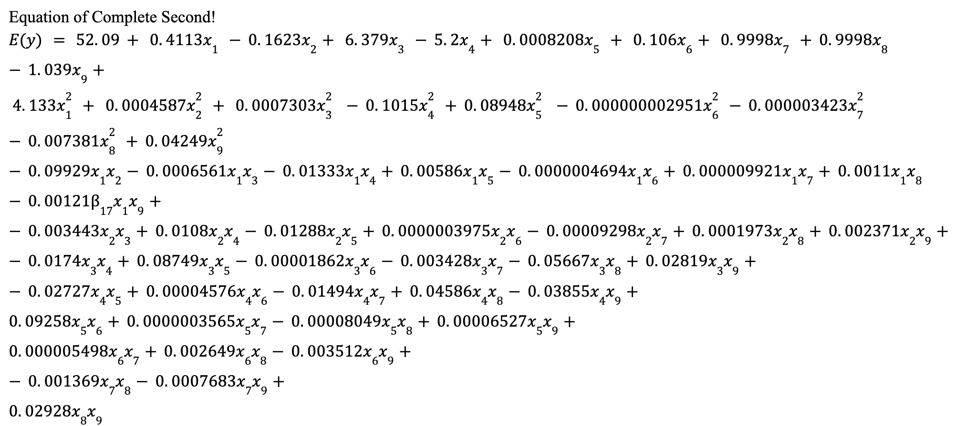
Equation of Complete 2nd Order Model
Notes:
55 Betas including the intercept

Slide 23
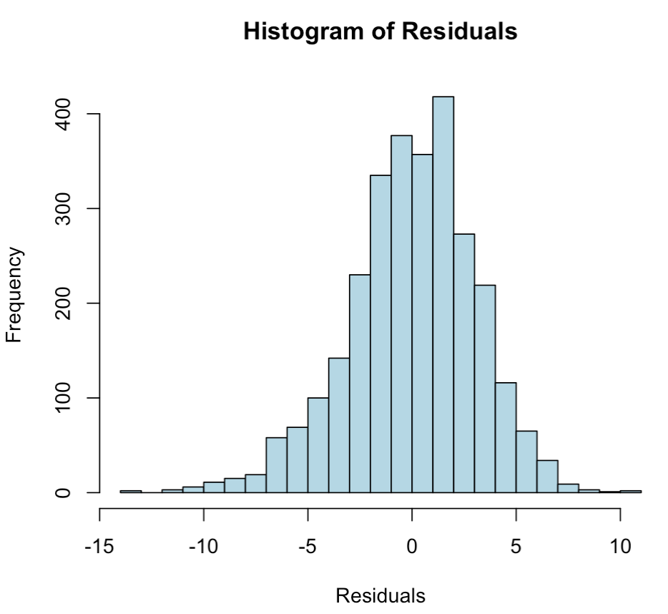
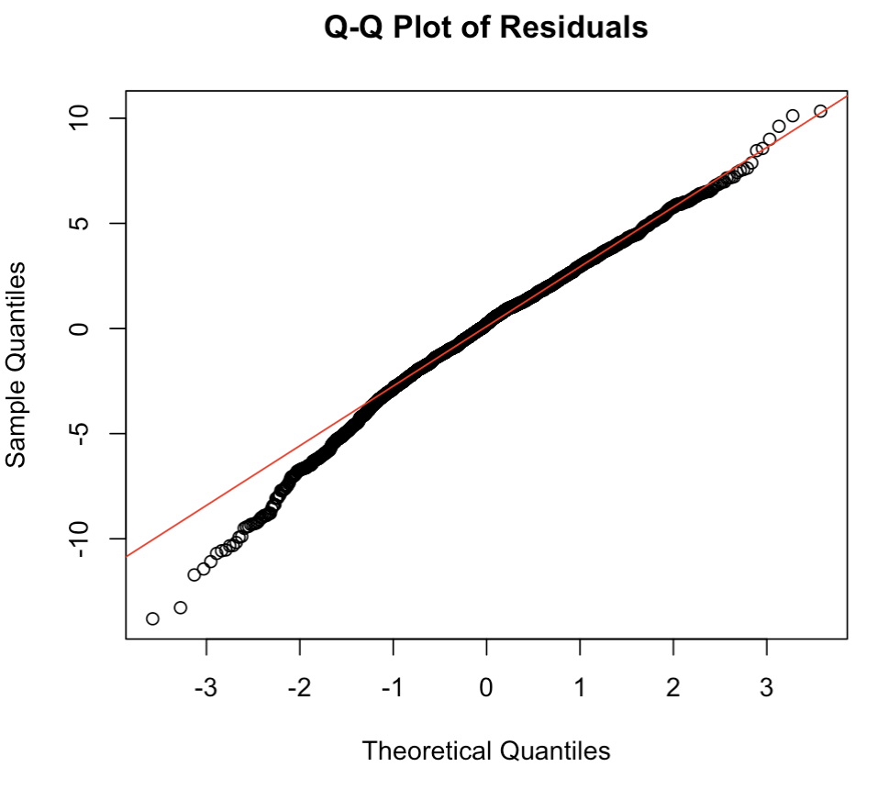
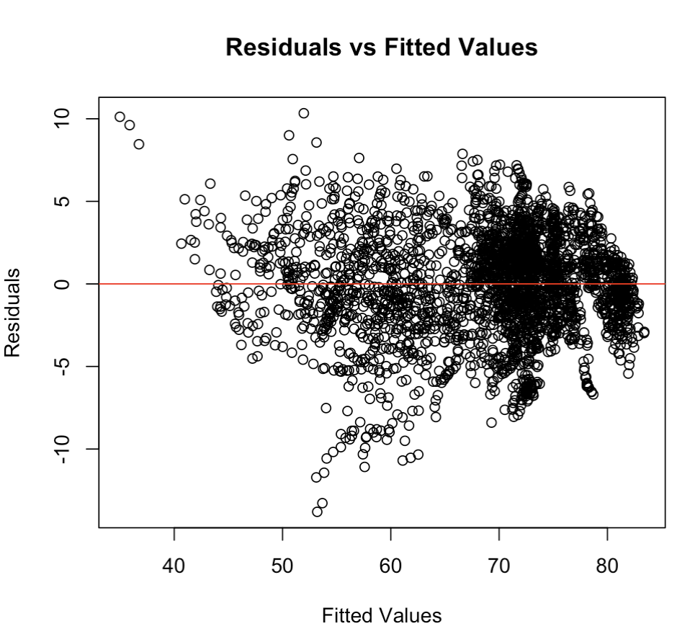
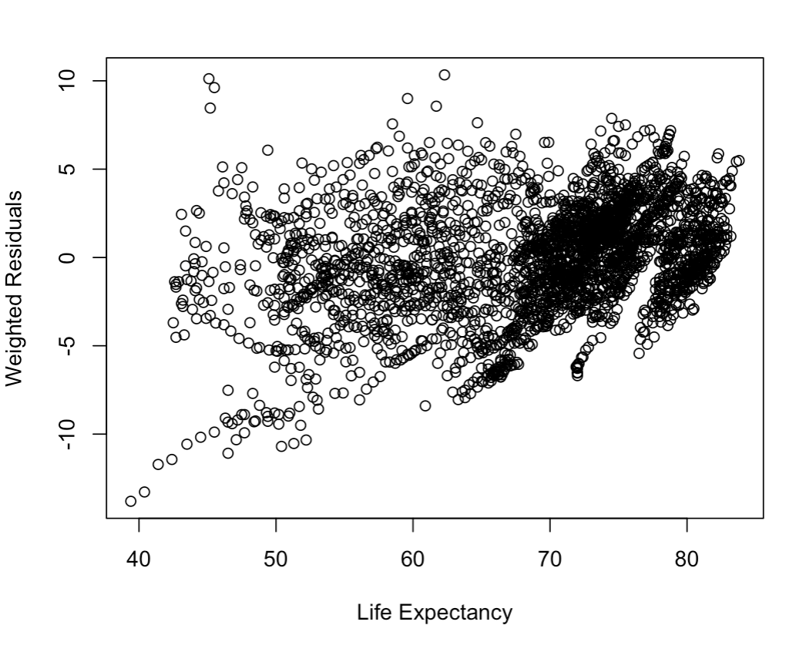
Residual Analysis
Random scatter ✅
Subtle signs of nonlinearity as there is more spread in lower-fitted values than higher-fitted values❗but nothing major
Follows a normal distribution and centering around 0 ✅
Approximately normally distributed
Mainly close to straight line – normality assumption holds ✅
Tails deviate❗but not significant enough to invalidate model
Indicates mild heteroscedasticity because the variance of residuals is not perfectly uniform
Notes:
Gelila

Slide 24
Conclusion: Prediction at the Country level
Dependent variable: Life_expectancy
Independent variables (9):
Hepatitis_B, Measles, BMI, Incidents_HIV, GDP_per_capita, Population_mln, Thinness_ten_nineteen_years, Thinness_five_nine_years, Schooling

